Slide 1
Q1 a) A balanced RYB-sequence Y-connected source with VRN=100∠10°V is connected to a Y−connected load (8+j4)Ω per phase. Calculate the line voltage and the phase and line currents, active power and reactive power.

Slide 2
Q1 b) A balanced RYB sequence Δ−connected load having impedance (20−j15)Ω is connected to a Δ−connected, positive-sequence generator having 𝑉𝑅𝑌=330∠0°V. Calculate the phase currents of the load and the line currents, active power and reactive power.

Slide 3
Q1 c) A choke of inductance 0.318 H resistance 30Ω is connected in series with 53μF capacitance across a 240V, 50Hz supply. Calculate (i) the circuit current, (ii) the circuit phase angle, and (iii) the power dissipated.

Slide 4
Q1 d) A current of (120-j50)A flows through a circuit when the applied voltage is (8+j12)V. Determine (i) impedance (ii) power factor (iii) power consumed and reactive power.

Slide 5
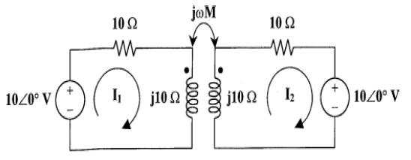

Slide 6
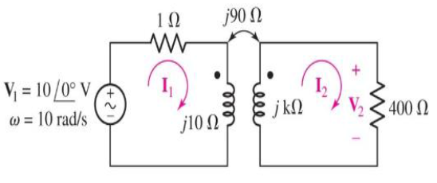

Slide 7
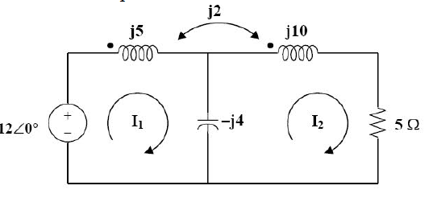

Slide 8
A ring is made up of two different materials i.e., cast steel and cast iron having relative permeability’s 1000, 1500 respectively. Lengths are 80 cm and 30 cm respectively. Airgap length is 2mm. The cross-sectional area throughout ring is 10 cm2. The magnetizing coil has 1000 turns and current 6A is allowed to flow through it. Calculate the flux produced in the airgap.

Slide 9
The armature of a 4-pole D.C. generator has a wave winding containing 750 conductors. Calculate the generated e.m.f when the flux per pole is 0.125 Wb and the speed is 1200 r.p.m.

